Slide 1

Web, Python and PostgreSQL Guide
By – Techcamp Kenya

Slide 2
CONCEPT 1: INTRO TO PYTHON
Introduction to Python
Installing Python
Rules of Naming in Programming
Introduction to VSCode and Python
Simple Python Program

Slide 3
Python Programming Training
• Why Variables are important in Programming
• Rules of naming in programming
• Proper indentation and keywords in Python
• Different data types in Python
• Arithmetic, Logical and Comparison Operators.
• Data structures in Python
• Control structures and decision making.
• Loops in Python
• Functions in Python
• Introduction to Classes and Object in Python
• Importing in Python

Slide 4
Never heard or used Python, So…
What is Python?
- Python is a free, open-source general purpose programming language with applications in web development (Websites and Online Systems), software development (Desktop Apps), API Development and Mobile App development (Kivy Framework).
NB: Python 2 is no longer supported we therefore shall use Python 3
Why Python?
Today there are so many programming languages to choose from and every one of them differs in ease-of-use, complexity and application. If you are just getting started in programming, we recommend a language with friendly syntax i.e human readable, easy to setup and has wide variety of applications. Python is best fit for all the above and is definitely here to stay.

Slide 5
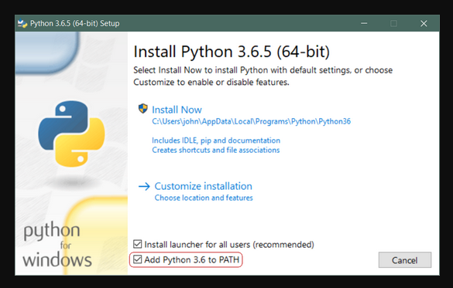
Installing Python
– Linux / Unix / OSX
▪ Run following commands in terminal - By default Python 2 is installed
-sudo apt update
-sudo apt install software-properties-common
-sudo add-apt-repository ppa:deadsnakes/ppa
-sudo apt update
- sudo apt install python3.9
– Windows
▪ Download & Install python3.9.x.exe. - https://www.python.org/downloads/releases
▪ Add to Python to Path
– Do so by checking the checkbox as indicated
Open terminal and type “python –version” to confirm it is added to the global variables

Slide 6
Rules of Naming in Programming (Variables/Functions/Classes)
They can not contain spaces e.g total marks. Should instead be total_mark (snake typing) or totalMarksScore (camel case).
They can not start with a number e.g “5totalMarks” but a number can follow in the name e.g it is allowed to have “total5”.
They can not contain special characters i.e “!@#$%^&*()” e.g it is not allowed to use “num%five”.
They can not contain keywords e.g “sql, functions, class..”. Please note that keywords differ from language to language, i.e SELECT is a keyword in SQL but not in Python, Class is a keyword in Python but not SQL and IF is a keyword in both. Be keen in identifying this.
Variable names are case sensitive. This means small x and capital X have different meanings.
You will get a, not defined error when you reference something that is not defined.
NB: Avoid using capital letters in your naming. Because the title case is used in defining Classes. And in PostgreSQL any capital letter in your naming would give you an error. KEEP EVERYTHING IN SMALL LETTERS BESIDES CLASSES.

Slide 7
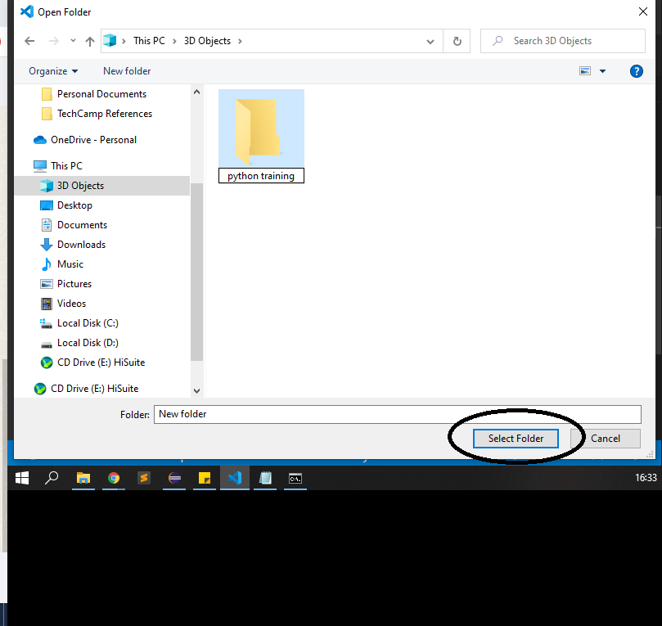
Create new Python project
All Python Files have the .py extensions and are interpreted by the python.exe that we have in our global variable.
Open VS Code and click on File->Open Folder. Change the new folder name created. And choose folder.
We shall only do this once as folder refers to a project, therefore all the files we will create in the next coming sessions will be saved there.

Slide 8
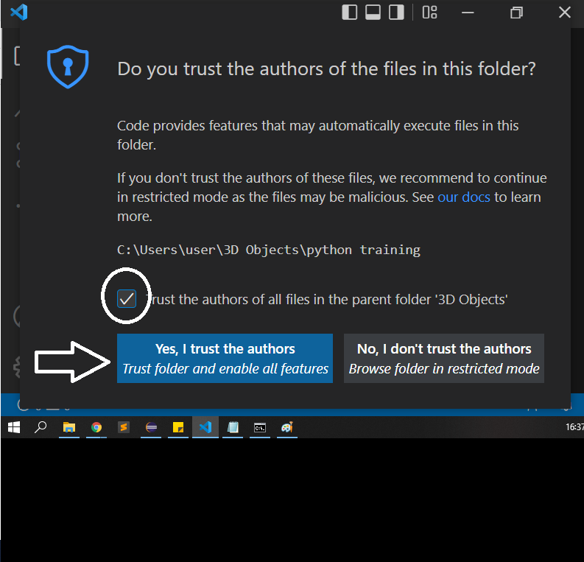
Allow VS Code to make changes to folder
Check the box “Trust the Authors”.
Click “Yes ,I trust”.
This gives VS Code permission to make changes to that folder.

Slide 9
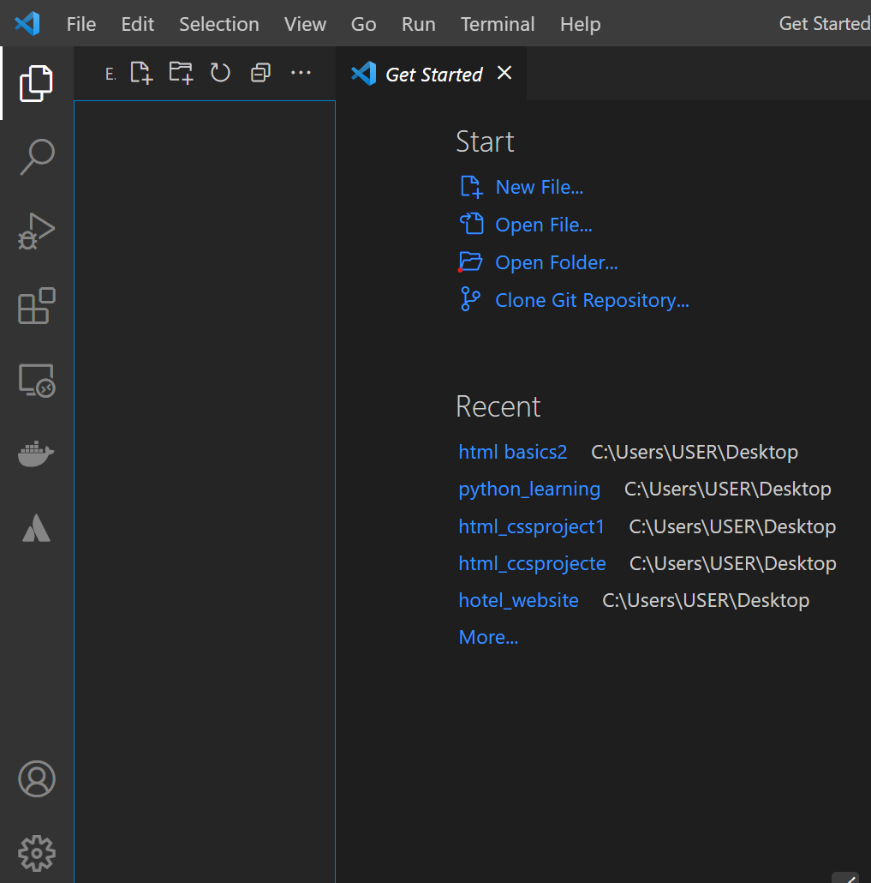
Create your first python file (hello.py)
In VS Code, hover on the folder name and you will see a prompt to create a new file.
Then give an appropriate name like hello.py
The file will open in the editor part and you will now be ready to start coding.

Slide 10
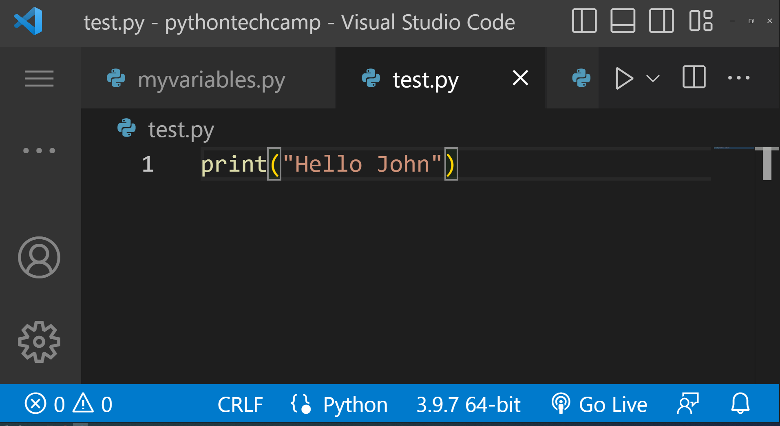
Print Function in Python
Use print() function. This is an inbuilt function in Python to display values in the console window in the terminal.
Syntax: print(“Hello John”) . This should display the word “Hello John”
NB: Note that using double or single quotes does not matter .
The console is the only interface we shall use in the Python Basics class. In the Python for Web Part of this training we learn about web frameworks, which is used to connect HTML/CSS/JS to Python and SQL.

Slide 11
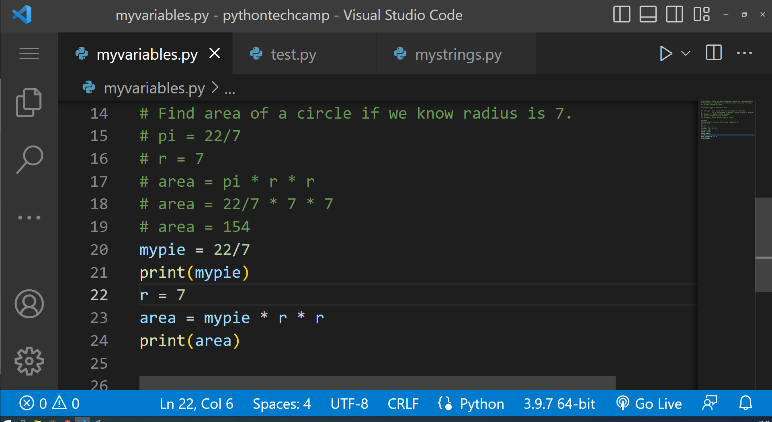
What is a Variable? “areaofcircle.py”
Create a file called areaofcirle.py.
The aim of this program is to show how to define and use variables.
When finding the area of a circle, we have to first define a variable holding the radius and also the value of pi that you want to use.
We do so as the program shows.
Once you calculate the area, you should store it inside a variable called lets say area, and print it to view the output.
NB: Note we did not need to add double or single quotes when adding numbers. That only applies to words (string).

Slide 12
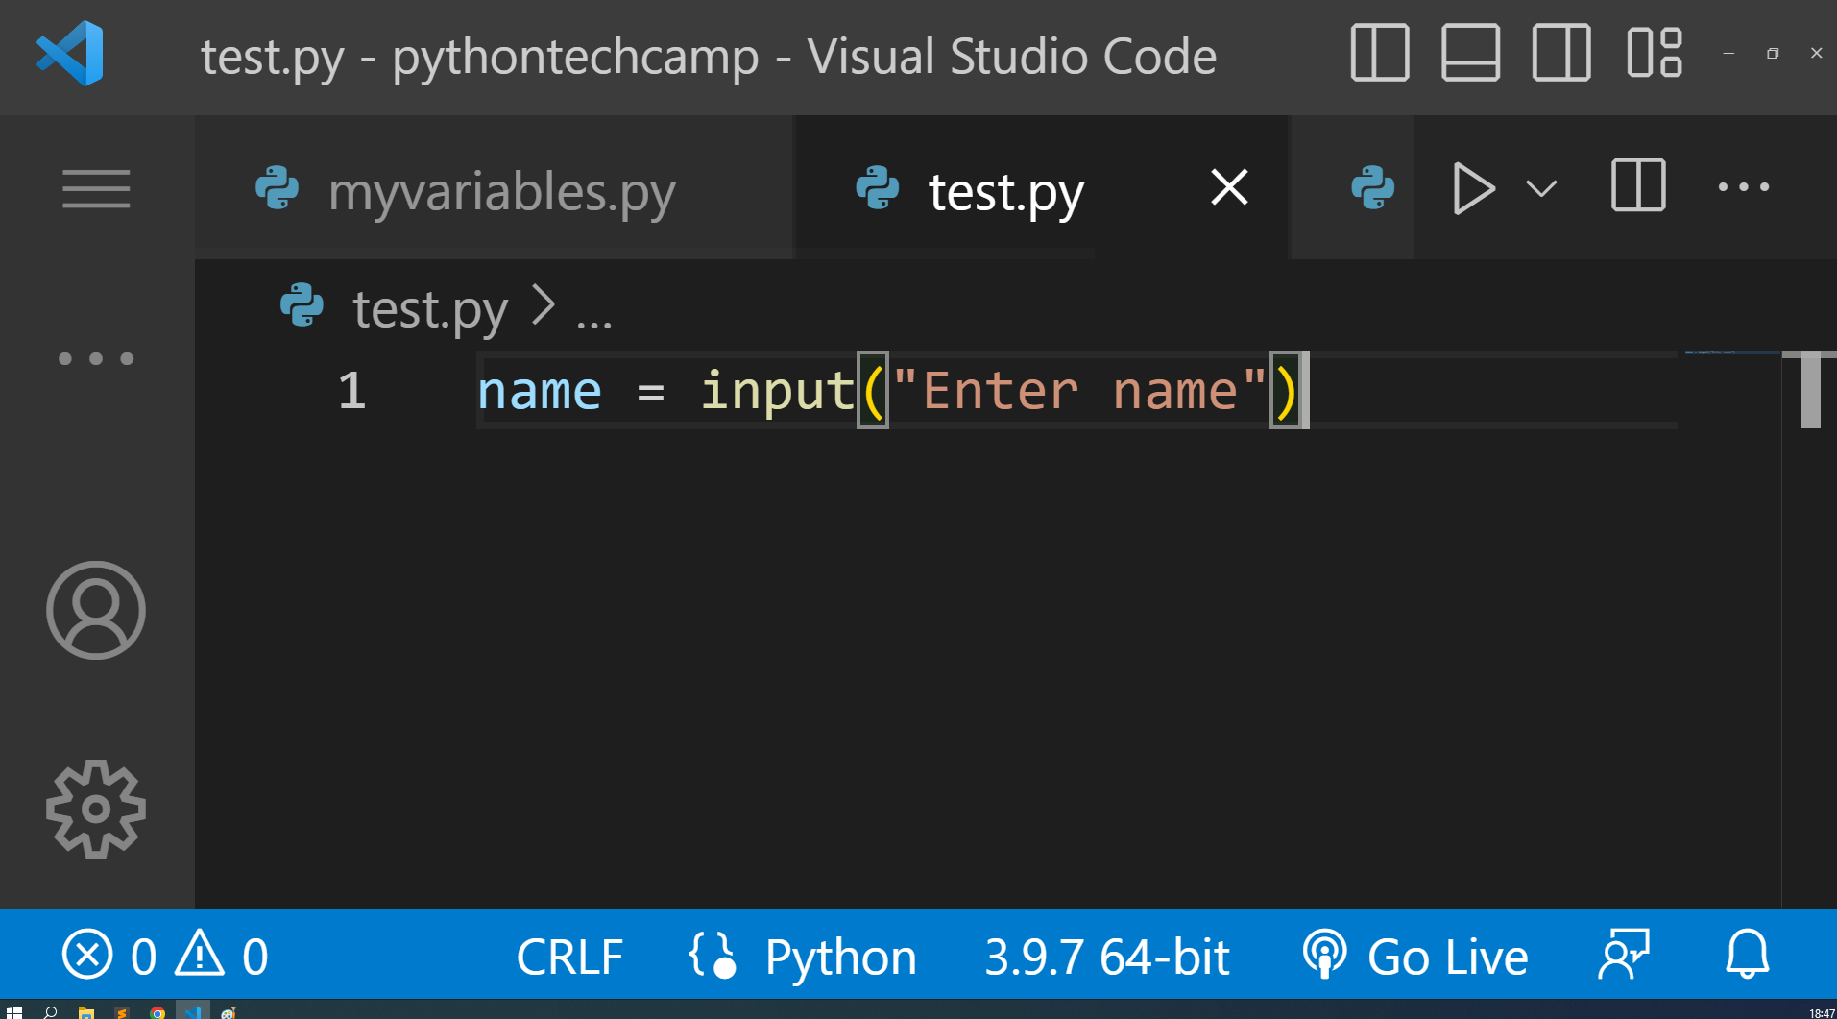
Input Function in Python
Use input() function. This is an inbuilt function in Python to take user input in the console window in the terminal.
Syntax: name = input(“Enter your name:”)
print(“Hello ” + name)
This should display the word “Hello John”
NB: Note that using double or single quotes does not matter .
The console is the only interface we shall use in the Python Basics class. In the Python for Web Part of this training we shall use an interface created using HTML and CSS.

Slide 13
Variables in Python
Variables - These are data containers which are represented by alphanumerics (alphabets and numbers) while observing of naming
e.g num5 instead of 5num
Different type of variables are
1. Strings - Is a value that has any type of character. It is surrounded by quotes (either single or double).
2. Integers - Number without decimal
3. Float - Number with a decimal
4. Boolean - Holds either True or False.

Slide 14
All variables are classes in Python
Every variable in Python belongs to a certain class. A class is a family of related operations or methods, that they can use. Methods are exactly like functions only that they belong inside a class.
We shall see the various methods that are usable inside the different variables types.
Example: A word belongs to the str class in python. There are some methods/operations that are specific to the str class/family only e.g .lower() or .upper() . These are operations used to convert a string to lower case or upper case.
We use a . to access the operations to be done on a variable.
To find out from which class a variable belongs to, you use the type() function:
print(type(variable))

Slide 15
CONCEPT 2: DATA TYPES IN PYTHON
String
Integers
Floats
Booleans

Slide 16
String
This is a variable used to hold all types of alphanumeric characters. All strings belong to the ‘str’ class. This means all methods that are part of the str class are applicable in every string.
Example:
first_name = “John”
second_name = “Doe”
print(first_name.upper()) # JOHN
print(second_name.lower()) # doe

Slide 17
String Operations
Inbuilt methods from the <class : str> are used to manipulate strings
Convert to upper case or lower case - string.upper() string.lower()
Strip - string.strip() to remove white spaces in the left and right.
Count - string.count(“character”)
Concatenate - string1 + string2
Indexing and Slicing Strings - string[0:], string[0], string[-1].
Length - len(string)
Split - stringWithDivision.split(criteria)
TASK: Given a sentence
Inbuilt methods from the <class : str> are used to manipulate strings
Convert to upper case or lower case - string.upper() string.lower()
Strip - string.strip() to remove white spaces in the left and right.
Count - string.count(“character”)
Concatenate - string1 + string2
Indexing and Slicing Strings - string[0:], string[0], string[-1].
Length - len(string)
Split - stringWithDivision.split(criteria)
TASK: Given a sentence

Slide 18
STRING.UPPER()
We use the .upper() method to capitalize all characters in the string
Example:
txt = "hello world"
x = txt.upper()
print (x)
output: HELLO WORLD

Slide 19
STRING.LOWER()
We use the .lower() method to change all characters in the string to lower case
Example:
txt = "Hello World"
x = txt.lower()
print (x)
output: hello world

Slide 20
.STRIP ()
Remove spaces at the beginning and at the end of the string
Example:
txt = " "
x = txt.strip()
print("of all fruits", x, "is my favorite"

Slide 21
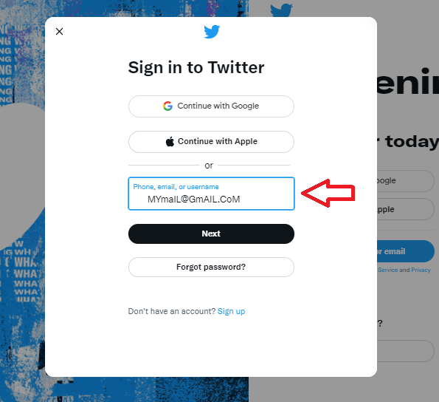
Scenarios where string methods apply: strip() and lower()
Problem:
In twitter register form, a user can type “dirty data” that contains spaces and mixed capitalizations, as shown in the picture.
Solution:
Once the data is sent to Python. We use strip() method to remove the left and right spaces. Then lower() so as to standardize whatever will be stored

Slide 22
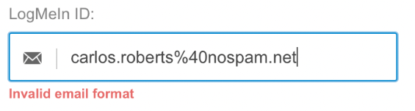
Scenarios where string methods apply: count()
Problem:
When inserting an email a user may submit an invalid email.
Solution:
To validate the email we can use the count function to check if a “@” sign appears in that string.
if the count is zero or more than one a notification should appear stating that the “email format is invalid”

Slide 23
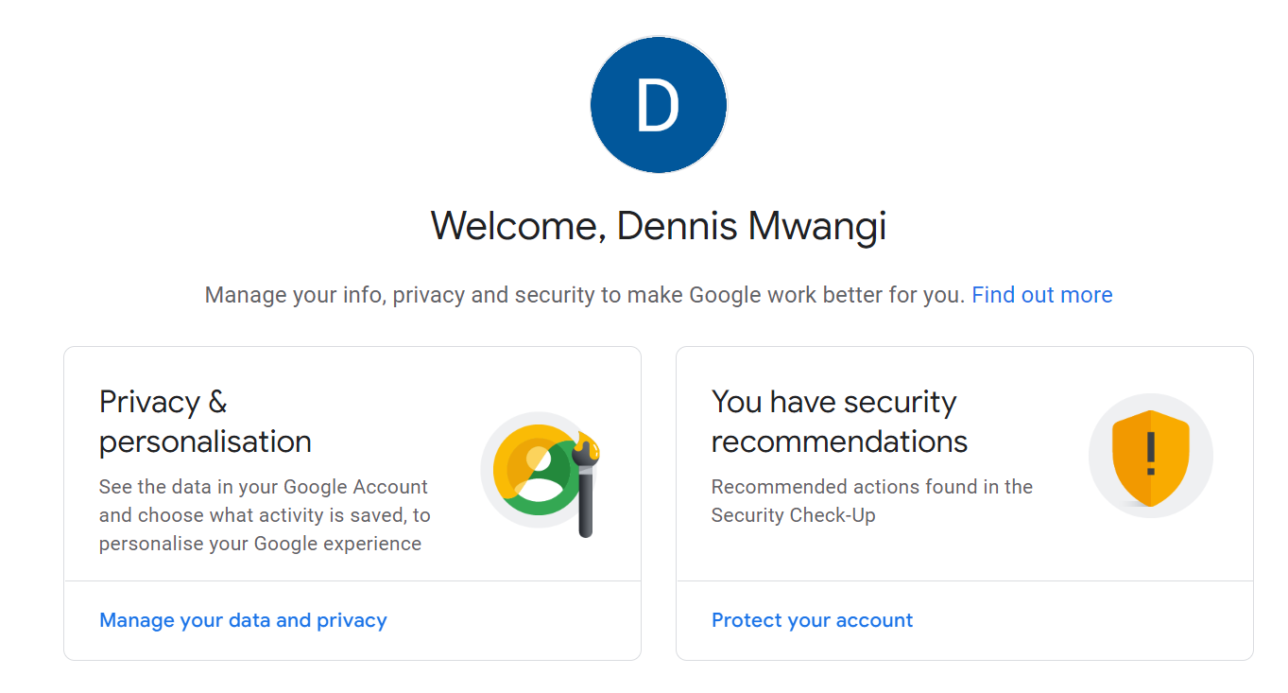
Scenarios where string methods apply: Concatenate
Problem:
when we sign up for a google account we insert the first name and last name on different input fields in the form.
Solution:
When we open the profile tab of our account after signing up the first name and last name are concatenated to one string .

Slide 24
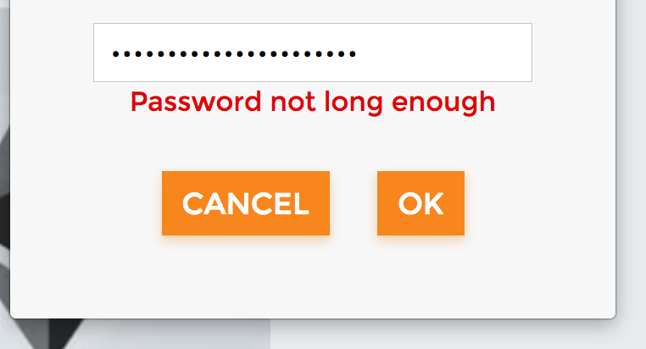
Scenarios where string methods apply: Length - len(string)
Problem:
A user might create a password that is too short and this may lead to the password being weak
Solution:
To validate the password length we can use the len function to check how many characters the user has inserted.
If they are the password is too short we may alert the user that the password is very weak.

Slide 25
TASKS: Strings
Create a new python file stringtask.py and attempt the 3 questions below:
Clean up the following variable to give the clean version in lower case. Using inbuilt methods in the str class
name = “ JOHn .“ to “john”
Slice the below string to get you the resulting sentence:
sentence_one = “The Dog Breed is German Shepherd” only display “Breed is German”
sentence_two = “Defeats for the Clinton forces, this was her moment of triumph” only display “Clinton forces”
Split the below sentence using a semicolon i.e ; And display length of the result.
“The lazy dog; ran so fast; it hit the wall.”
Attempt questions in the link below. Whether you get the right answer or not, still read the solution explanation.
https://realpython.com/quizzes/python-strings/

Slide 26
Integers and Floats
Integers are variables which have only whole numbers, either positive or negative. E.g
-3000,...,-1, 0, 1,.....3000
Floats are variables which have decimal points. These are both positive and negative.
-3000.5993, ……..,-1.678,0,0.56,....3000.00
Doubles are variables with a very large decimal number

Slide 27
Float and Integer Operations
These are methods for variables from <class int> and <class float> same operators we use in math operators.
+ (addition operator) Example: x = 2 y = 5 z = x + y
- (Subtraction operator) Example: x = 2 y = 5 x - y = -3
* (Multiplication operator) Example: x = 2 y = 5 x * y = 10
/ (Division operator) Example: x = 2 y = 5 x / y = 0.4
** (Exponential operator) Example: x = 2 y = 5 x ** y = 32
% (Modulo operator - This is the remainder of division)
Example: x = 2 y = 5 y % x = 1
// (Floor operator - Division that result into whole numbers)
Example: x = 30 y = 7 x // y = 4

Slide 28
TASKS: Floats and Integers
Questions
Convert a float to an integer with an inbuilt function in Python
temp = 56.8926 to 57
Convert the float below to give the results as follows
temp = 56.8926 to 56.89
Convert the float below to give the results as follows
temp = 56.8926 to 56.893
Convert the float below to give the results as follows
temp=56.8926 to 8.926
NB: Use string slice & concatenation, but have result as float
Attempt questions below. Whether you get the right answer or not, still read the solution explanation.
https://realpython.com/quizzes/python-data-types/

Slide 29
CONCEPT 3: OPERATORS ON VARIABLES
Assignment Operators
Comparison Operators
Logical Operators

Slide 30
2. Assignment Operators
These are operators used to shorten arithmetic operations operators.
Example:
x=3
x = x + 3 = 6 is same as x+=3 # the result is 6
x = x * 3 = 9 is same as x*=3 # the result is 9

Slide 31
Comparison Operators
These operators check the following:
< (less than) Example: print(3<10) True
> (greater than) Example: print(5>3) False
== (Check equality) Example: print(10==10)True
!= (Check Inequality) Example: print(3!=4) True
>= (Greater than or equal to): print(3 >= 3) #True
<= (Less than or equal to): print(3 <= 2) #False

Slide 32
Logical Operators - AND
AND - returns true only if all conditions are true.
A B A and B… A or B
True True True True
True False False True
False True False True
False False False False
# If one expression fails the whole condition fails
print(34 != 67 and 78 > 89 and 45 == 45)
False

Slide 33
Logical Operators - OR
OR - If at least one condition is true, the the entire statement becomes true.
A B A or B
True True True
True False True
False True True
False False False
# If one expression true the whole condition true
print(34 == 67 or 45 < 9 or 6 > 8 or 8 < 9)
print True

Slide 34
Logical Operators - NOT and IN
NOT - used to invert the current boolean. This occurs when your intention is to get the opposite of some result. Example: Get values that do not have the word “no”

Slide 35
TASKS: Booleans

Slide 36
CONCEPT 4: DATA STRUCTURES
Introduction to Python Data Structures
Lists
Tuples
Dictionaries
Task

Slide 37
Various Data Structures in Python
List
Tuples
Dictionary
Sets

Slide 38
List
Lists is a data container that holds more than 1 variable. They need NOT be of the same Datatype.
Imagine fetching data from a row in a database. For example you can have records belonging to a person in a list.
A list is defined using square brackets and each value is referenced using an index starting from 0, 1, 2 and so forth.
Example is: person = [“John Doe”, 30, “john@mail.com”, “Nairobi”]
To access the name we use: person[0]
To access the age: person[1]
TASK: Create a List of days of the Week. Print the day today using an index.

Slide 39
List Operations/Methods
len(list) - Gives the length of the list.
list1 + list2 - Concatenate two list
Repetition - list1 * 4
Membership - “Wednesday” in daysOfTheWeek (Returns a Boolean)
Delete element in a list - del list1[2]
Update values in a list - list[2] = 65
Adding a value at end of list - list1.append(“new values”)
Get values in a section, range or a specific index using colon.
Slicing in lists are done exactly how it's done in strings. You use
mylist[index where to start : count where to stop]

Slide 40
Task: Lists
trainees = ["John", [2, ["James","Mary"]]]
1. Display 2 using index, from the list.
2. Output James using index, from the list.
3. Using a method add 56 at the end of the list.
4. Using a method add the name Mike between James and Mary
5. Change the value of 2 to 8
6. Remove John and Mary from the list.
7. Using a function, determine the length of the list
Notes:
trainees = ["John", [2, ["James","Mary"]]]
print("Original list: ",trainees)
#1. Display 2 using index, from the list.
print(trainees[1][0])
#2. Output James using index, from the list.
print(trainees[1][1][0])
#3. Using a method add 56 at the end of the list.
trainees.append(56)
print(trainees)
#4. Using a method add the name Mike between James and Mary
trainees[1][1].insert(1, 'Mike')
print(trainees)
#5. Change the value of 2 to 8
trainees[1][0] = 8
print(trainees)
#6. Remove John and Mary from the list.
trainees.remove('John')
print(trainees)
trainees[0][1].remove('Mary')
print(trainees)
#7. Using a function, determine the length of the list
print(len(trainees))

Slide 41
Tuple
A tuple is a data structure that is used to hold multiple values but the values can not be changed or removed from the set. We say a set is immutable. The data inside the tuple is fixed
Defined exactly same way as a list except you use round brackets i.e (2,3,”John”, ['Irene', True, 78, 78.2397]) instead of [2,3,”John”].
days = ("monday","tuesday","wednesday","thursday", "friday","saturday","sunday")
#1. Find wednesday using an index
#2. Using a function a find the length of the tuple.
#3. Replace Thursday with Thur

Slide 42
Set
A set is a data structure that is used to hold only unique values.
days = {"monday","tuesday","wednesday","thursday", "friday","saturday","sunday","sunday","sunday","sunday"}
print(days)
print(days[1]) - this displays tuesday
Remove friday and sunday from the set using methods.
Add them back to the set

Slide 43
Dictionary
Let say you have a very large list/tuple for you to access values you have to count through the index. This can become very hard and impossible for large lists.
Therefore dictionaries solve this using key:value pairs. Defined inside curly braces.
Example: person = {“name” : “John Doe”, “age”:30, “location”: “Nairobi”, “email” :”johndoe@mail.com”}
Accessing a dictionary: print(person[“name”])

Slide 44
Dictionary Operations/Methods
Please note that a key can not be repeated in a dictionary. If you define a key and try to create another, the previous value will be replaced.
Keys are case sensitive i.e “Name” is different from “name”.
You can get a list of all keys by using person.keys(). This can help you create a boolean to check if a key exists. When you enter a key that doesn't exist, you get a key error so instead create a boolean to check if a key exists using the in operator.
A value in a dictionary can be of any datatype, but the key always has to be string.

Slide 45
TASK: DATA STRUCTURES
Create a file called mydstask.py and attempt the below questions:
my_ds = [23, “Jane”, (560), [“Lesson”, “Maths”, {“currency” : “KES”}], 987, (76,”John”)]
1. Print KES
2. Print 560
3. Print Maths
4. In the dictionary with the key currency, add another key “amount” with value 90
5. Reverse 987 to 789 without using an inbuilt -method or Assigning 789 manually.
Hint: Strings can be reversed using [::]
6. Change the name “John” to “Jane” .
You can research or discuss to find the solutions above.
https://realpython.com/quizzes/pybasics-tuples-lists-dicts/

Slide 46
CONCEPT 5: CONDITIONAL STATEMENTS
Conditional Statements - IF Else
IF - ELIF Statements
Tasks

Slide 47
IF, ELSE Statement
In most programs you will be encountered with a situation where you have to take a certain path if the results of a condition is TRUE or take another if FALSE. We use IF and ELSE Statement to make such a decision.
average_marks = 70
if (average_marks > 50) and (average_marks < 100):
# This runs if it is true
print(“ You have passed the class”)
else:
#This runs if it is false
print(“Fail”)
NB:The indentation space only has to be same in a specific block. A block is specified using a full colon.

Slide 48
IF, ELIF, ELSE Statement
In most programs you will be encountered with a situation where you have to check more than 2 possible conditions.We use IF and ELIF Statement to make such a decision and finish with an Else statement.
#Take user input and ask them for their marks. Print their grade.
average_marks= 70
if average_marks >= 70:
print("A")
elif average_marks >= 60 and average_marks < 70:
print("B")
elif average_marks >= 50 and average_marks < 60:
print("C")
elif average_marks >= 40 and average_marks < 50:
print("D")
else:
print("E")

Slide 49
Nested IF Statement

Slide 50
TASK: IF Statement
Take three inputs from a user, separately. Print the largest of the numbers.
Hint: Determine what type of data is taken in as input

Slide 51
CONCEPT 6: LOOPS
While Loop
For Loop

Slide 52
For Loop...
A for loop is used to perform a repetitive task over and over. You can also loop through a list and get individual values as below:
1. An example of how you can loop through all numbers between a certain range is:
for i in range(0,15):
if i % 2 == 0:
print(i)

Slide 53
While Loop...
You can also use a while loop to constantly loop until a condition is false. This means we should find a way to change the condition by either incrementing or decrementing a value to stop the loop.
i = 0
while i < 20:
print("Less " + str(i))
i = i + 1

Slide 54
TASK: Loops

Slide 55
DAY 8
Let's A moment to Understand functions
Functions
Tasks

Slide 56
A little bit about functions
Functions are used only to organize your program. Functions are usually reusable and can be passed different values to give different outputs.
When you are building a program, you have to organize your code better, through putting each task/functionality in their own block of code called functions.
These blocks are invoked when they need to be used.
There are inbuilt functions and custom functions in programming.

Slide 57
Examples of functions
Example of inbuilt functions are like:
round(), range(), str(), type(), tuple(), print()
Examples of custom functions, lets say you are building the instagram app:
login(), register(), forgot_password(), follow(), unfollow(), like(), unlike(), subscribe(), manage_products(), share(),add_photo(), logout()

Slide 58
More about Functions
In functions variables are called parameters and are only visible inside a function.
Values passed to a function are called arguments.
1. A function takes in some data.
2. A function does a certain task or functionality.
3. A function give or returns some processed info.
Example of this:
login()
data - username, password
task - clean up the data then check if they match the ones in a database.
info - data type of output is: boolean(True or False)

Slide 59
Task: Functions
Write a python program that takes from a user 5 inputs (maths, eng, swa, sci, sos).
Create a function that calculates the total marks another the average marks ,then a functions that finds the grade according to the table below.
Use the value from total to get the average and average to find the grade.
A > 79 , B - 60 to 79, C - 59 to 49, D - 40 to 49, E - less 40

Slide 60
Function definition.
A function is a block of code that is used to perform a single task. The function could return a value, or not. Although, it is always best to return a value after the task is done.
Python function syntax is as below:
def function_name(parameter1, parameter2,..):
#perform task here
return result
Finally call function to start using it
function_name(argument1, argument2,..)

Slide 61
Let take a moment...
For example you have input marks of 500 students and you want to generate and display grade for each student, which approach would you take? Let everyone try this ….
With the knowledge we have now, when you want to do a certain task multiple times, you will have to rewrite the statement as many times as you need to right?

Slide 62
Understanding why to use functions.
As your program in the previous slides starts to grow it gets hard to add new features, when using procedural programming. That is when a program runs sequentially following a linear approach.
In the previous task, if we add a new feature e.g hostel, teachers, which class a student belongs to and so on.. It gets harder to add the features at the correct position in a procedural program.

Slide 63
Functions..
def totalMarks(m,e,s,sci,sco):
total = m +e +s+sci+sco
return total
def avgMarks(total):
avg = total / 5
return avg
def findGrade(avg):
if avg > 80:
return “A”
total =totalMarks(2,3,45,6,7)
average = avgMarks(total)
grade = findGrade(average)

Slide 64
PYTHON TASKS
At this point in time you are now ready to handle the questions using functions.
To better test your understanding, avoid google the questions directly. Refer to this documentation for syntax referencing.
Access the tasks using link below:
https://docs.google.com/document/d/1-Ab875zFetxly3m9670LGmySF7hnTtOMLZCp_qm9NQU/edit?usp=sharing

Slide 65
CONCEPT 1 :RDBMS AND ERD
Why we need to learn Databases
Understanding RDBMS and SQL
Database Schema and How to come up with one
Why RDBMS
Primary keys and Foreign keys
RDBMS Questions

Slide 66
Why should we learn databases?
Coming from using spreadsheet or text files as a data storage you will find that there are so many limitations in how many data records you can store, data types that you can store and many other challenges including security.
As your data grows you need a better storage system that accurately records data, updates, tracks them on an efficient and regular basis.
Companies can address their challenges on one hand and make use of the immense potential offered by databases.
READ MORE HERE

Slide 67
Intro to database?
When create a dynamic application, whether web or mobile you need a data source with well organized data.
Your options are an SQL database or a NoSQL database.

Slide 68
SQL databases?
An SQL database is used 90% of the time and is a database where data is stored in tables rows, and columns.In SQL data stored is structured and observes strict data types and data completeness.
NB: Every table must be related to at least one other table. i.e a table can be either a parent a child or both. Example is like tables categories, products and sales. In this case, categories is the parent for products and products is the parent for sales.
categories(parent for->) - products(parent->) - sales
In short NO lone table exists and IF IT CANT BE DONE IN MS. EXCEL, IT CAN'T BE DONE IN SQL.

Slide 69
NoSQL databases?
A NoSQL database is a more flexible database where data is stored in JSON Format and does not have any strict data types.
The records are stored in collections and documents.

Slide 70
What is RDBMS and SQL and how are they related
SQL (Structured Query Language) is the language used to manipulate a database.Create, Select, Insert, Update and Delete data.
Relational Database Management System (RDBMS) is the basis for all SQL Databases.Here every table must have a relationship with another. Data in databases is stored in structures called tables. Tables are divided in columns (Vertical Entity) called fields and records (Horizontal Entity) also called rows.
Different types RDBMS/SQL Databases in the market right now are: MySQL, PostgreSQL, MSSQL, Oracle...etc
If you are coming from a spreadsheet background like Ms Excel, think of an excel workbook as a database, an excel sheet as a table, excel columns as fields and records as rows.
READ MORE HERE

Slide 71
Database Schema/Entity Relationship Diagram and Example Test Case
Before creating any application that uses SQL database, you need to create a diagram that shows tables and their parent <->child relationship. This diagram is called an Entity Relationship Diagram (ERD). This is the structure representing the logical view of the entire database.
Example
We will use the test case a Bank e.g Equity Bank. Think of the banking business model. The start from the top of the bank’s highest hierarchy. This is where we get branches and departments, each branch also has multiple departments, each department has employees, each branch also has bank account types,and each customer can have multiple bank accounts in any branch.
If we are to create a database schema from the above scenario, the following tables: branches, departments, employees, customers and accounts.
The next page shows a diagram of the schema

Slide 72
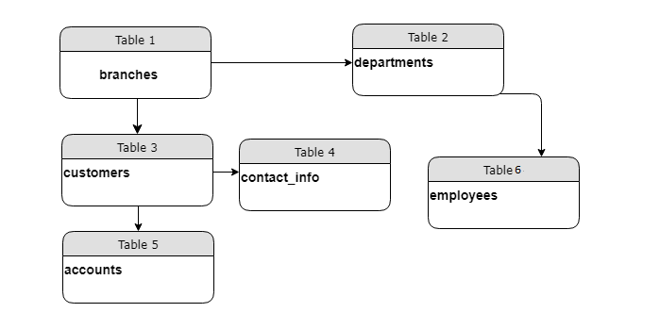

Slide 73
QUESTIONS: RDBMS
Do this in ms excel. Create data for Jumia by factoring in parent - child relationship. Start from the top of the hierarchy naming the worksheets and any important columns:
Do this in excel. Create data for Sasini Tea and Coffee company in Kenya, by factoring in parent - child relationship. Start from the top of the hierarchy naming the worksheets and any important fields:

Slide 74
Primary key and Foreign Key?
A Primary Key - is a special column in a table to uniquely identify records in a table. A primary key's main features are: It must contain a unique value for each row of data. It cannot contain null values. E.g Your National ID number is unique being that it identifies you uniquely.
A Foreign Key - a foreign key is a column in the child table that identifies a row from the parent table. Note that a foreign key in a child table is usually associated with a primary key in the parent. E.g An orders table contains a product_id column to identify the product associated with the order.

Slide 75
Types of Relationships?
As you can see in the previous diagram, each of the entities are connected and therefore a relationship exist within them.There are 3 types of relationships which exists within tables.
One to One - Means one record in the parent table is associated with one and only one record in the child table. For example, each customer_id has one and only one contact_id.
One to Many - One record in a parent table is associated with one or more records in the child table. Each customer can have many accounts.
Many to Many - occurs when multiple records in a parent table are associated with multiple records in another parent table. E.g Customers can purchase various products, and products can be purchased by many customers

Slide 76
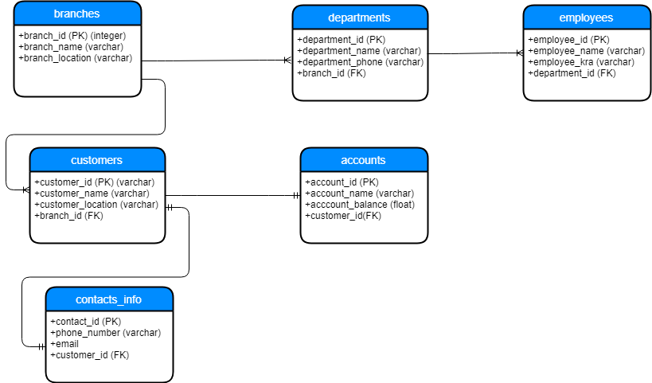

Slide 77
CONCEPT 1 QUESTIONS: RDBMS
Create full ERD for Jumia by factoring in parent - child relationship. Start from the top of the hierarchy naming the worksheets and any important columns:
Create full ERD of Sasini Tea and Coffee company in Kenya, by factoring in parent - child relationship. Start from the top of the hierarchy naming the entities and the any important fields:
Research on the concept called Database Normalization.

Slide 78
CONCEPT 2: SQL QUERIES
SQL Queries
Basic SQL Questions

Slide 79
SQL QUERIES?
Click here to open SAMPLE DATABASE
SELECT(Fetch data from table/s)- SELECT field1,field2,... or * FROM table_name
INSERT(Insert a new record into table) - INSERT INTO table_name (column1, column2, column3..)
VALUES (value1, value2, value3 ...);
UPDATE (Update existing record in a table)- UPDATE table_name
SET column1 = value1, column2 = value2, … WHERE condition;
DELETE(Delete record in a table) - DELETE FROM table_name WHERE condition;

Slide 80
SQL QUERIES?
Click here to open SAMPLE DATABASE
Querying data
SELECT column1, column2, column3, ...
FROM table_name
WHERE condition
GROUP BY column1, column2, ...
HAVING condition
ORDER BY column1, column2, ... ASC|DESC
LIMIT number;

Slide 81
SQL QUERIES?
Click here to open SAMPLE DATABASE
INSERTING DATA INTO A DATABASE TABLE
INSERT INTO table_name (column1, column2, column3, ...)
VALUES (value1, value2, value3, ...);

Slide 82
SQL QUERIES?
Click here to open SAMPLE DATABASE
UPDATING DATA IN A DATABASE TABLE
UPDATE table_name
SET column1 = value1, column2 = value2, ...
WHERE condition;

Slide 83
SQL QUERIES?
Click here to open SAMPLE DATABASE
DELETING DATA FROM A DATABASE TABLE
DELETE FROM table_name
WHERE condition;

Slide 84
CONCEPT 2 QUESTIONS: SQL QUERIES
READ MORE ON SQL HERE AND ANSWER THE BELOW QUESTIONS USING THIS DATABASE
Insert a customer in the customers table,view the record and update the record
Insert an order for the Customer inserted in number 1 above,choose employee and shipper.
Insert a new record in the Products table attach them to an existing supplier and category.
Insert an orderdetail using the order in 2 above and product in 3.
Delete Customer whose CustomerID is 56.
Show customers who come from brazil or italy.
Display Customers who have the word ‘son’ in their CustomerName.
Display orders made in the month of October 1996, display in asc order.
Find the total orders shipped by each of the 3 shippers.
Display products whose price is above 25.

Slide 85
CONCEPT 3 : TABLE JOINS
How to get records in related tables
Different Types of Joins
Sketch of W3Schools Database
SQL Data Mining Questions

Slide 86
How to get records in related tables
A well normalized database will contain many foreign keys in related tables therefore when fetching data (i.e SELECT) there will be digits representing the record in the related table.
The best way to display the values is if we perform a join which is used to combine rows from two or more tables, based on a related column between them. This will now give you access to the other records in the related table as opposed to displaying a foreign key digit.
There is INNER JOIN, LEFT JOIN, RIGHT JOIN,FULL OUTER JOIN
READ MORE HERE

Slide 87
JOINING RELATED TABLES
(INNER) JOIN: Returns records that have matching values in both tables. View example here
LEFT (OUTER) JOIN: Returns all records from the left table, and the matched records from the right table. View example here
RIGHT (OUTER) JOIN: Returns all records from the right table, and the matched records from the left table. View example here
FULL (OUTER) JOIN: Returns all records when there is a match in either left or right table. View example here

Slide 88
CONCEPT 3 QUESTIONS :SQL DATA MINING
How to get records in related tables
Different Types of Joins
Sketch of W3Schools Database
SQL Data Mining Questions

Slide 89
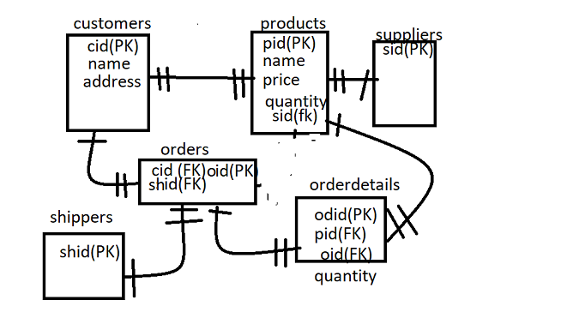
Below is a sketch of the w3schools database

Slide 90
CONCEPT 3 QUESTIONS :SQL DATA MINING
Data mining Using SQL: Use the ERD on the Previous Slide
READ MORE ON SQL HERE AND ANSWER THE BELOW QUESTIONS USING THIS DATABASE
Display a single relation with: OrderId, OrderDate, CustomerName, City, Address, PostalCode, ShipperName, ProductName, Quantity.
Display all products ever been ordered and display the shipper name.
Display the count of all products shipped by each of the 3 shippers.
How many customers DO NOT have the words ‘son’ in their CustomerName.
Find the total sales made in the year 1997.
Find the top supplier of the business (in terms of products ordered).
Find the total sales of each product.
Find the best performing month in the business in terms of sales. Hint: Use substr() on the date to slice
Find the total sales per day.
Find the total Sales for each Customer, the ones who have never ordered leave as 0.
In the same database, create the table payments and determine the foreign key, any relevant columns and their respective data types. Insert at least 5 records.

Slide 91
CONCEPT 5 : PostgreSQL DB
Installing PostgreSQL
What is PostgreSQL
Using PSQL
Using PgAdmin4
Generate Mock Data
Queries on PostgreSQL

Slide 92
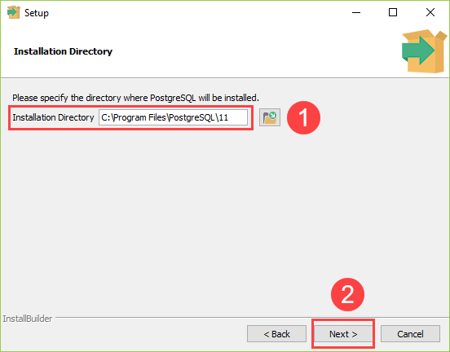
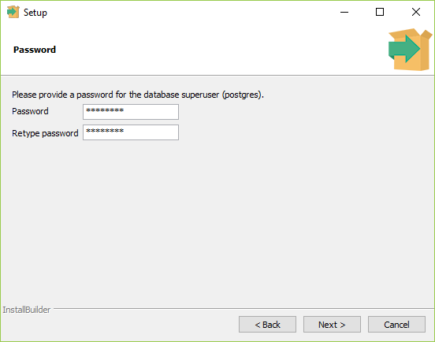
Download PostgreSQL Database HERE and PgAdmin HERE. Install the database as below and
make sure to enter a password you can remember.

Slide 93
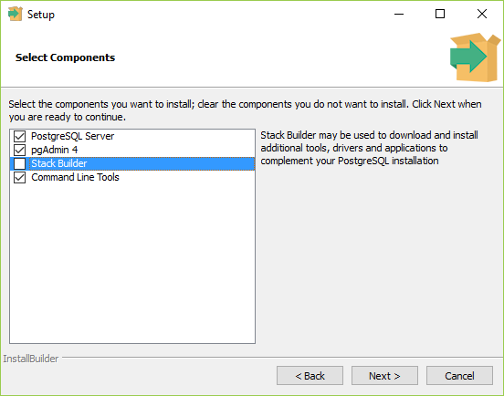
You can uncheck stack builder and PgAdmin.
Follow installation process.

Slide 94
What is PostgreSQL
-PostgreSQL is an RDBMS database that uses SQL in its querying. The database is open source and has multiple features for working with all kinds of data including very commonly GIS.
-PostgreSQL is a background service that runs constantly in your computer and can only be accessed using either PSQL or PGAdmin4.
- When connecting to any database, you need the host, user, password and database_name.
-By default the user is postgres, password is the one used when installing and host is localhost.
Download PostgreSQL 14.7 Here

Slide 95
What is PostgreSQL
-PostgreSQL is a background service that runs constantly in your computer and can only be accessed using either PSQL or PGAdmin4.
- When connecting to any database, you need the host, user, password and database_name.

Slide 96
USING PSQL
Open PSQL on your computer. Located in the postgres folder in your apps.
On the terminal press enter on the host,user and port options.
Then on the password type the password used during installation. You will not see the password while typing. Once you type it fully, click enter.
View list of databases: \l
Connect to a database: \c databasename
View list of tables in database: \dt
Exit a database: \quit

Slide 97
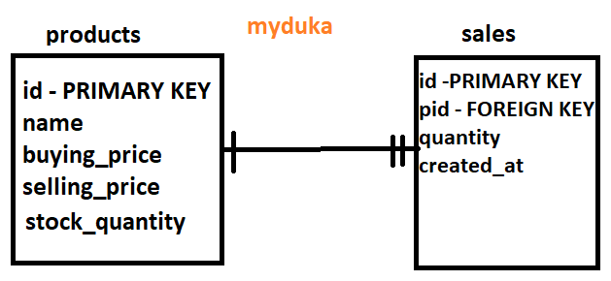
We want to create a database of a sales management system. Below is the ERD Diagram

Slide 98
SQL ON PSQL
# This is used to create a database
CREATE DATABASE myduka;
# Connect to the database
\c myduka
# We create the table products. id is SERIAL so that it autogenerates, VARCHAR is a string of up to 255 characters. NUMERIC is a number with 1st part represents the characters and 2nd the decimal places
CREATE TABLE products (id serial PRIMARY KEY, name VARCHAR ( 100 ) NOT NULL,
buying_price NUMERIC(14, 2), selling_price NUMERIC(14, 2), stock_quantity INT DEFAULT 0);
# The table sales is a child table for products and has a FOREIGN KEY pid. This is attached with the primary key for products using FOREIGN KEY. When a primary key is updated in the parent, it cascades to the child records and a product is restricted to be deleted if it has sales records attached to it.
CREATE TABLE sales (id serial PRIMARY KEY, pid int, quantity numeric(5,2), created_at TIMESTAMP, CONSTRAINT myproduct FOREIGN KEY(pid) references products(id) on UPDATE cascade on DELETE restrict);

Slide 99
Questions: On PSQL Using myduka Database
Insert at least 3 products in the table and display them on psql or pgadmin. Use SQL Queries that you used before when learning SQL.
Create at least two sales for each of the 3 products added above.
Write the query to find the total profit per product.

Slide 100
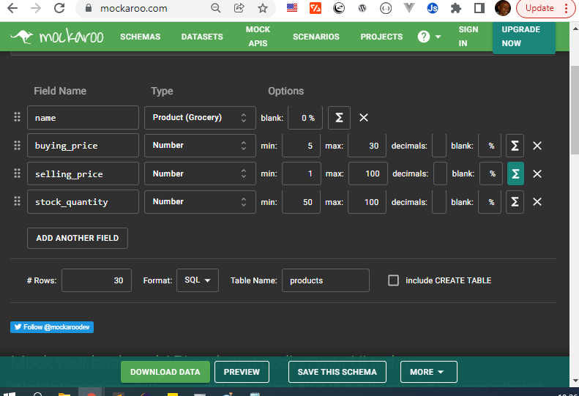
MOCKAROO DATA GENERATION
We would like to generate some fake data so that we can have a realistic shop or “myduka”.
To achieve this we will use the FREE Mockaroo plan to generate data. Since the free version only allows upto 1000 rows, we will generate only 30 products and 1000 sales.
Let us start with the products table and generate the random data by setting all columns as this:
Also the selling_price column will be an equation which is buying_price * 1.3
We remove the id column since it was set to serial therefore it will generate automatically
Finally change the rows to 30, format as SQL and table name as products. Click preview. You should see some insert queries

Slide 101
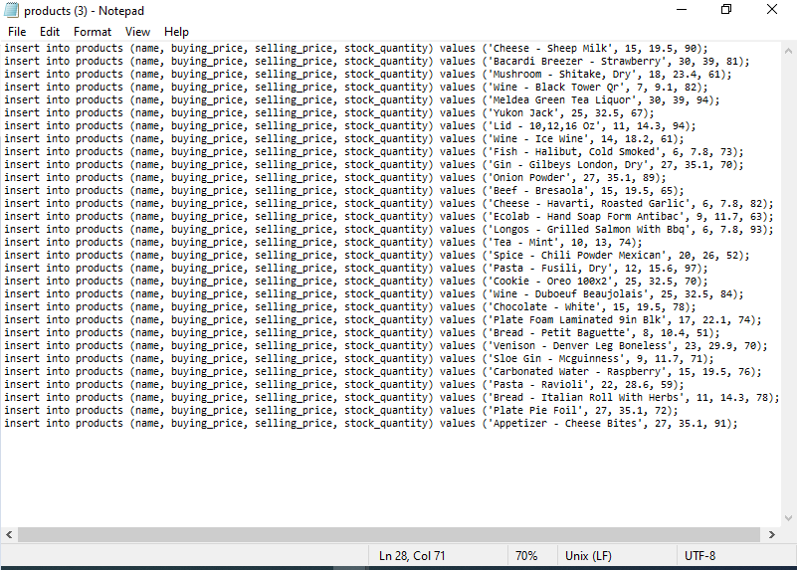
PREVIEW AND ADD MOCK PRODUCTS
We can now preview on mockaroo to see the queries that will add the 30 products.
Then download the data and open it with a text editor like notepad as shown.
Select all of them, then copy to get ready to paste to psql or pgadmin.
Remember to first connect to the required database and then paste the queries.
NB: Incase you get an error when pasting the query, redo it

Slide 102
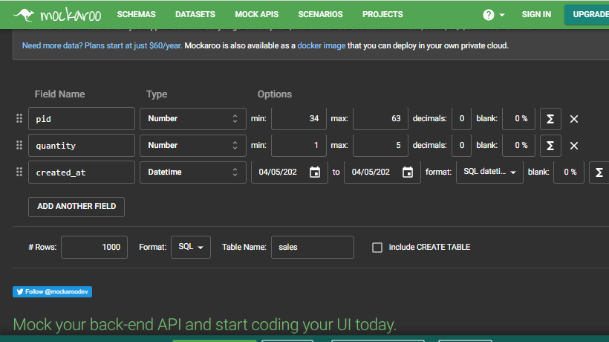
GENERATE MOCK SALES
We can now generate 1000 sales from mockaroo. We will however need to factor in that we have to match an existing product. To find out your least primary key in products and max primary key use the below queries:
min val:
select * from products order by id asc limit 1;
min val:
select * from products order by id desc limit 1;
- We will do this by setting the column pid to the type number but put min = (min val above) and max = (max val above).
- Also remember to clear any equation present on any field. And Change created_at to datetime type and the format to SQL datetime
Download data and open with notepad and paste as before.

Slide 103
EXTRA STUFF ON SQL USING PSQL
# Adding Check constraints
ALTER TABLE public.products ADD CHECK (selling_price > 0) NOT VALID;
ALTER TABLE public.products ADD CHECK (stock_quantity > 0) NOT VALID;
# Creating Views in SQL:
CREATE VIEW product_sales AS SELECT * FROM products as p join sales as s on p.id=s.pid;
SELECT * FROM product_sales;
Questions:
Display each product with the total profit made and save the query in a view called myprofits.
Display sales made per month and save in a view called monthly_sales.

Slide 104
Back to Python
Deeper into Functions
Importing in Python
Classes and Objects

Slide 105
More on Functions, Classes and Objects in Python
By – Techcamp Kenya

Slide 106
Python functions task before starting Classes
To remind you how to use functions do the below task:
1. Create a program called cubetask.py that takes an input the length of a cube then prints the area and also the volume.
Have two functions called area and volume, that have the input as the argument and returns the area to be printed and the other the volume.

Slide 107
A bit more on functions
You can also set a default value in a parameter (variable) in a function. This sets a value to the parameter if it happens one was not sent on function calling. below is an example.
def volume(length, width=30):
v = length * length * length
return v
vl = volume(l)
print(vl)

Slide 108
Introduction
Back in functions we modularized our code into functions: To calculate total, calculate average, then find grade.
All the above functions are related and would therefore make sense if we modularize our program more by grouping them together into structures called Classes.

Slide 109
Classes and Objects
A Class in simple terms is a collection of related methods(functions) and variables. It should always start with a capital letter and always in singular form e.g Student.
A Method is a function defined inside a class.
An Object is an instance of a class i.e It represents 1 student accessing the Student class.
A Constructor is the first method to be called when an object is created/class is instantiated.
An instance variable is a variable defined inside a method.
*** Next is an Image representation of the “Student” class**

Slide 110
Create a Student class with its methods
Create a student class and add methods to calculate total,average and grade.
Then the methods should be able to change/alter certain class variables (total,average and grade)
To make the process a bit more automated,call the methods upon construction of the class.

Slide 111
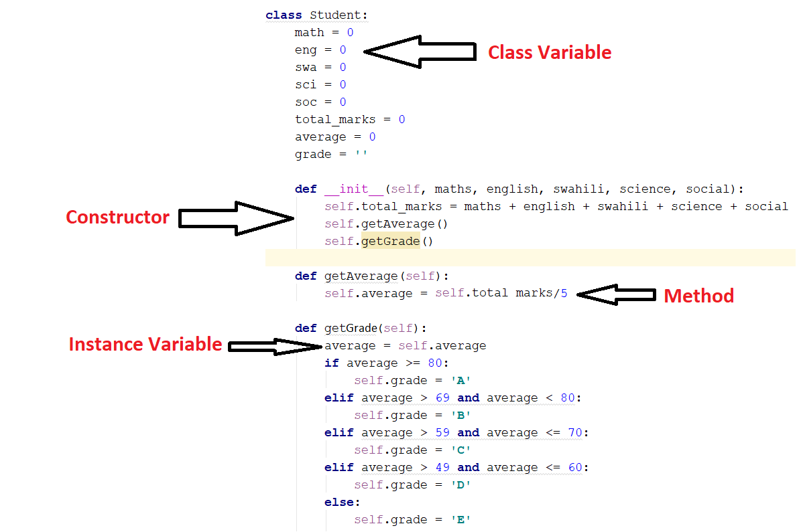

Slide 112
Explaining the Student Class
Create a student class and add methods to calculate total,average and grade.
Then the methods should be able to change/alter certain class variables (total,average and grade)
To make the process a bit more automated,call the methods upon construction of the class.

Slide 113
Defining Objects/Creating class instances
student_one = Student(57,89,63,72,92)
To access their total mark: student_one.total_marks
To access their average mark: student_one.average
To access their grade: student_one.grade
student_two = Student(66,7674,55,54,92)
To access their grade: student_one.grade

Slide 114
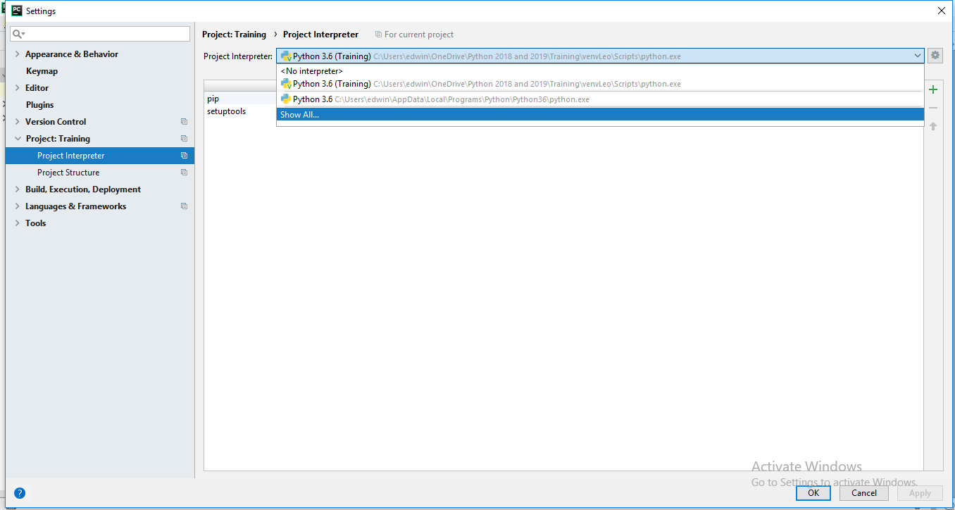
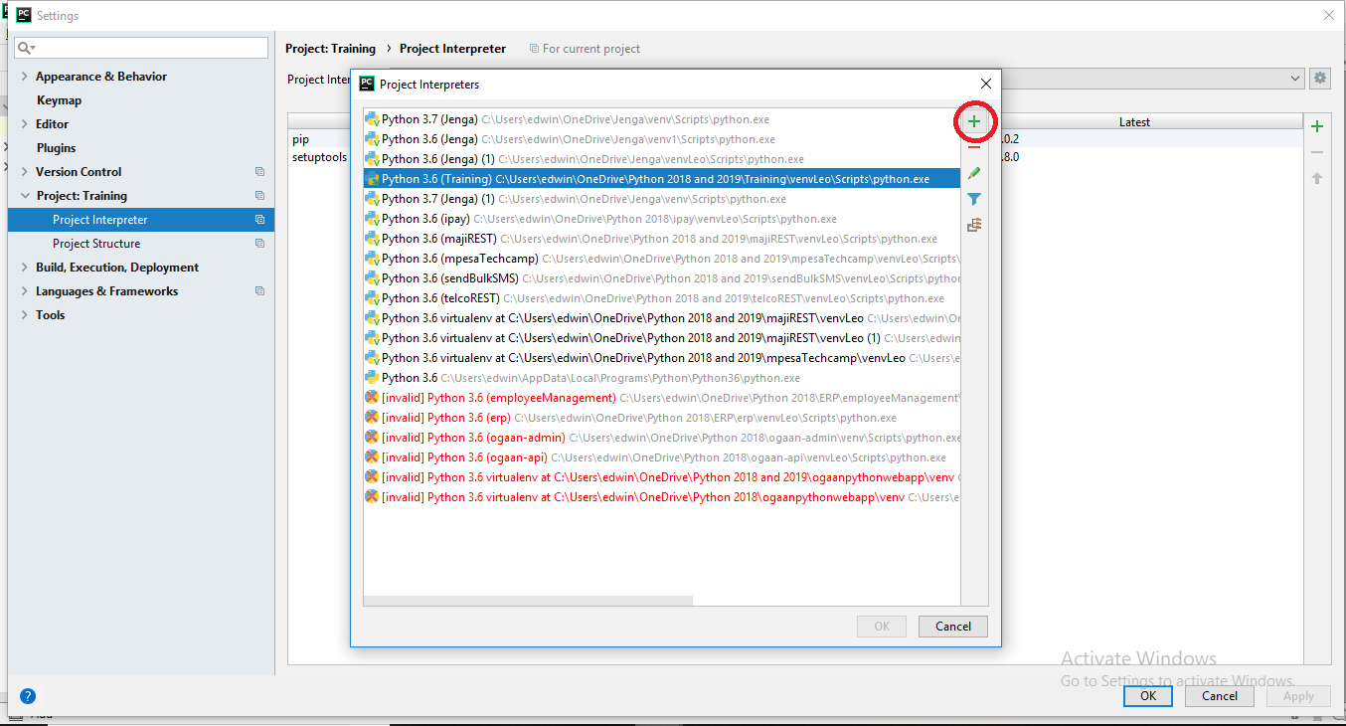
Virtual Environment in Python
A virtual environment is a folder created inside your project folder that contains the Libraries/Modules that are required in the particular project.
You will learn more about Virtual environments once you start using external libraries in the
future clases.
To Create a Virtual Environment
Open Pycharm and click on File->Settings. Click on dropdown on Project Interpreter then click show all, Add on the plus button to click a new one.

Slide 115
CONCEPT 1 :HTML &CSS
Hypertext Markup Language (HTML)
Cascading Style Sheets (CSS)
Bootstrap
Simple Website Creation (My Portfolio)

Slide 116
CONCEPT 2: Bootstrap Framework
What is Bootstrap Framework
Bootstrap Starter Template
Bootstrap Components
Bootstrap Grid
Bootstrap Themes Free

Slide 117

Bootstrap.
Bootstrap is library used to style web applications.It is responsive(adapts well to both desktop and mobile browsers).
The best documentation of anything(any library ) is its official documentation.The official documentation can only be as bad as the code.
go to bootstrap quickstart page and add bootstrap to your project.
ASSIGNMENT: 1.Students should create a layout using bootstrap.
2. Create tables that has all the names of records of her peers in the class and what they know about their peers.

Slide 118
About Bootstrap Framework.
Bootstrap is library used to style web applications.It is responsive(adapts well to every device browser).
The best documentation of anything(any library ) is its official documentation.The official documentation can only be as bad as the code.
Go to bootstrap quickstart page and add bootstrap to your project.
Ensure you learn about: starter template, navbar, slider, cards, grid system, forms, modal, tables…

Slide 119
Introduction to web development.
Before we can write some lines of code, we are going to go through some common web development terminologies that we are going to encounter as web developers.
Front-end - this is the interface user the user(web visitor) interacts with, including the designs. also referred to as the client-side
Back-end - Handling the “behind the scenes functionality” eg connecting to a database. also referred to as server-side
Web client - refers to the web browser in a users machine.
Web Server. - A program that uses HTTP to serve files that form webpages

Slide 120
Web development terminologies.
URL. - (Uniform resource locator) - the address of a resource on the internet. also known as web address. urls have the following format protocol://hostname/other-info eg. https://techcamp.co.ke
Request. - A message from a client to a server asking for a resource
Response - An information request message sent from server to the client
HTTP. - (Hypertext Transfer Protocol) - Rules that govern communication between client and server
Web Framework. - A software designed to support development of web applications.

Slide 121
Getting started with Flask
Flask Framework/Library - this is a python framework used to connect the Frontend (HTML) and the server. We create routes (URLs) to bind to a python function. In the function is where we right the application logic e.g Get request data,perform calculations,save to database etc…
You can view the official flask documentation here ,take some time and go through the documentation.

Slide 122
Getting started with Flask
Enough with the theoretical bits, let's create our first flask application.
We are going to create a new project on pycharm, name it say employeesManagementSystem.
We are then going to cover some basic routing. create several routes
We will start by understanding the basic concept of creating routes(urls) using flask

Slide 123
Introduction to Jinja2
Jinja is a web template engine for python programming.
Jinja provides some features such as template inheritance,automatic html escaping among others.
We are not going to go through a lot on jinja but you can read more about jinja in the official documentation.
We shall dwell on some common features that we will interact using jinja.

Slide 124
Introduction to Jinja2
templating languages contain variables as well as programming logic which when evaluated(rendered into html) are replaced with actual values.
Variables or programming logic are placed inside tag or delimiters.
For example, jinja template uses {% %} for expression or logic(like loops), while {{ }} is used for outputting the results of an expression or a variable to the user.
NOTE: jinja templates are just .html files

Slide 125
Introduction to Jinja2: Template inheritance
The most powerful thing about jinja is the concept of template inheritance.
Template inheritance will allow you as a developer to build a base “skeleton” template that will contain all common elements of your site and define blocks that child templates can override.
Sound’s complicated? Let's understand more by using an example.

Slide 126
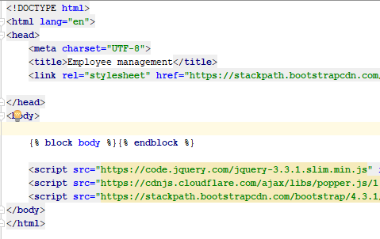
Template inheritance: Base template
Now, remember all our html files should always be inside the templates folder.
Lets create a new html file and call it base.html

Slide 127
Introduction to git and GitHub
What is git?
Git is a command line tool, it is free and open-source distributed version control system for tracking changes in source code and is used for software development.
It allows you to record changes in your file over time so that you can access specific versions of your file later on. Moreover, you can also coordinate with several people working on a single file or files with the help of git.
Git is a software that we will need to download, Download git

Slide 128
Git setup
After downloading git, accept all default configs and wait for it to the installation process complete
we the need to tell git who we are, we do do by running the below commands
git config --global user.name "github_username"
git config --global user.email "email_address"
Note: Replace github_username and email_address with your GitHub credentials.

Slide 129
Git setup Generate ssh keys
SSH stands for Secure Shell and is a method used to establish a secure connection between two computers.
SSH works by authenticating based on a key pair, with a private key being on a local machine and the corresponding public key on a remote server. When the keys match, access is granted to the remote user.
to generate keys, run the below command:
ssh-keygen
3. You’ll be asked to enter a passphrase. Hit Enter to skip this step.
4. The system will generate the key pair, and display the key fingerprint and a randomart image.
5. Open your file browser.
6. Navigate to C:\Users\your_username/.ssh.
7. You should see two files. The identification is saved in the id_rsa file and the public key is labeled id_rsa.pub. This is your SSH key pair.

Slide 130
What is GitHub ?
GitHub is a Git repository hosting service, but it adds many of its own features. In simpler terms, github will store your project for you.
While Git is a command-line tool, GitHub provides a Web-based graphical interface. It also provides access control and several collaboration features of which some will be introduced at a more advanced level. Link to Github

Slide 131
Basic Version Control
initialize a git repository with the following command: git init
This creates a new subdirectory named .git that contains all of your necessary repository files — a Git repository skeleton. At this point, nothing in your project is tracked yet. This is only done once, that is, when we want to track a project using git
Next command:
The git add command adds a change in the working directory to the staging area. It tells Git that you want to include updates to a particular file in the next commit.

Slide 132
Make your first commit in git
git commit -m "commit-text"
Pushing to github:
git push origin master will push your changes to the remote server.
git push origin master

Slide 133
Version Control.
Version control is a system that will record changes in a file/files over period of time.
git init(do only once) - Initialize your repository for the first time.
1. git add * -
We’ll refer to Techcamp Git tutorial for more about Git .

Slide 134
SKIP BELOW TO WEB SLIDE

Slide 135
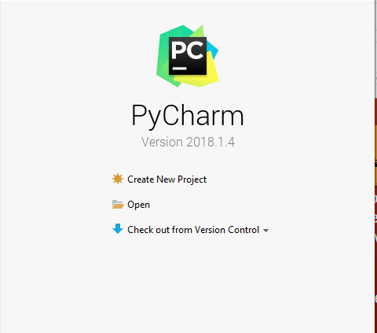
Working with Flask
To create a new Flask project using pycharm click on Create New Project

Slide 136
Template inheritance
This template that we have defined as base.html defines a simple HTML “skeleton”.
It is the work of “child” templates to fill empty blocks with content.
The example in the previous slide, you will notice that we have {% block body %} {% endblock %} . This defines a block with a name called body(you can give it any name) in which any child component can fill in.
Note, all that the block tag does is to tell the template engine that a child template might override those placeholder.

Slide 137
Template Inheritance: Creating a child template
We are now going to create a child template.
We use the {% extends %} keyword. This tells the template engine that this child template is inheriting another template.
When the template engine evaluates this template, it will first locate the parent. (NB: the extends tag should be the first tag)
The next step is to create a block in which we will write our html tags for this specific template.
use {% block body %}{% endblock %} , then in between the blocks place in your html tags
Now, create a new html file and call it department.html then you should have the following code.(next slide)

Slide 138
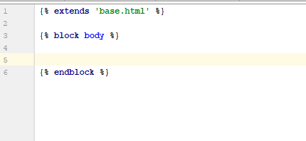
Template inheritance: creating child template
You should now something like this in the department.html
Inside the block body tags is where we will include the html tags.
So, now head on to bootstrap and copy a modal, and inside the modal body, copy a form and paste it.
Replace the various labels inputs.

Slide 139
Template inheritance:
Repeat the same procedure to create the employees.html . and the homepage.html
Inside the block place page content.

Slide 140
Creating a Navbar using Jinja
Next thing, we want to have a common navbar across all our pages.
We are going to create a folder named includes . In this folder we will have our navbar.html inside.
Again, we will copy a navbar from the bootsap.Inside the navbar.html

Slide 141
Introduction to SQLAlchemy
SQLALCHEMY - Its is a python SQL toolkit and ORM for python.
Flask-SQLAlchemy is a flask extension that adds support for SQLAlchemy

Slide 142
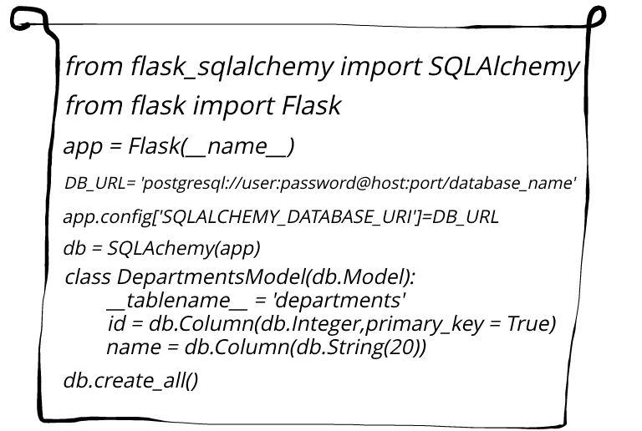
The anatomy of an ORM.
An ORM is Object Relational Mapper.
It takes class models from python
and makes them database tables.
Takes class methods and executes
them as SQL statements.
We’ll use flask-sqlalchemy in this
particular bootcamp.
Study the code on the left

Slide 143
Day 13

Slide 144
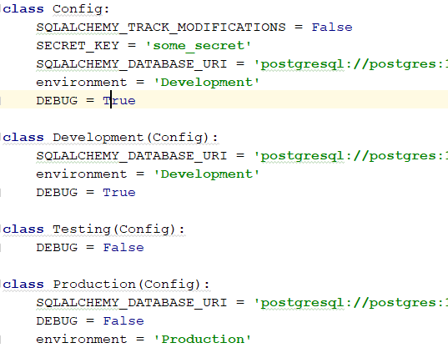
Creating flask environments in config
Let’s create a class-based config file.
Create four classes namely Config,
Development, Staging and Production
with attributes as shown
Apart from the Config class,all the
other classes are subclasses(inherit)
the Config Class.place the various
configurations based on the env.

Slide 145
Models.

